Slide 2
Cross (Micro)Services Communication…
Async? Using: Message Queue
Reliable? Using: Message Queue
Sync? Using: Http / Rest API
No Peek Loading? Using: Message Queue
If you want all together ?

Slide 3


Slide 4
Message Queue Based RPC
Andrew Wu, Chief Architect @ 91APP

Slide 5


Andrew Wu 是誰?
Chief Architect @ 91APP
Microsoft MVP
曾任: 一宇數位科技 技術長
Microsoft Azure Cafe, TechDays, TechEd 講師、專欄作家…
談論各種軟體開發與設計的大小事，有 20 年的大型與雲端服務的開發經驗。喜歡研究各種技術背後的原理與實作細節，期許自己做個優秀的架構師。研究主題以: .NET / C# / OOP / Container / Microservices / Distributed System 為主軸，同時在部落格上也持續分享相關主題的一系列文章。期許能將這些領域的實作經驗分享到社群。

Slide 6
AGENDA
Message Queue Basic
Design (Architecture)
Implementation & Demo

Slide 7
Message Queue Basic

Slide 8
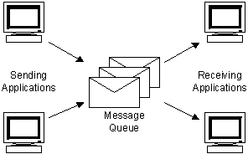
(BASIC INTRODUCTION)
https://tw.saowen.com/a/63c04f9638e1f962669b04d6acc6b6eae697b42978b338384c0a8626bf3de617
Notes:
Basic: store and forward, queue 可以當作 buffer, 不論是 client or server 短暫離線都不會有影響

Slide 9
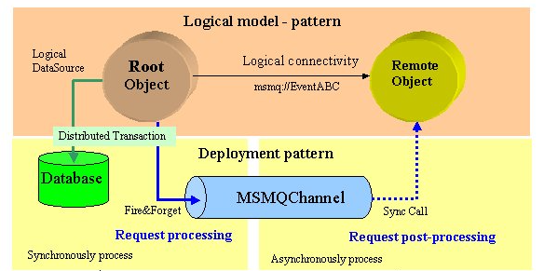
邏輯上的傳輸通道
這部分對 Client 而言是非同步的操作。
這部分是同步
的操作。
https://tw.saowen.com/a/63c04f9638e1f962669b04d6acc6b6eae697b42978b338384c0a8626bf3de617

Slide 10
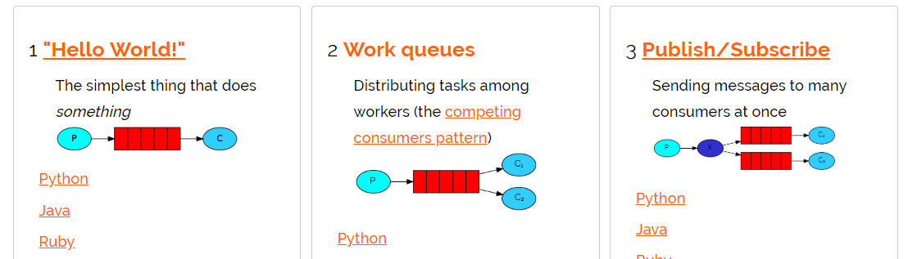
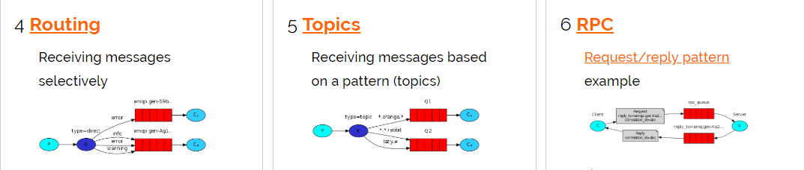
http://www.rabbitmq.com/getstarted.html

Slide 11
設計上的挑戰 (架構)

Slide 12


Slide 13
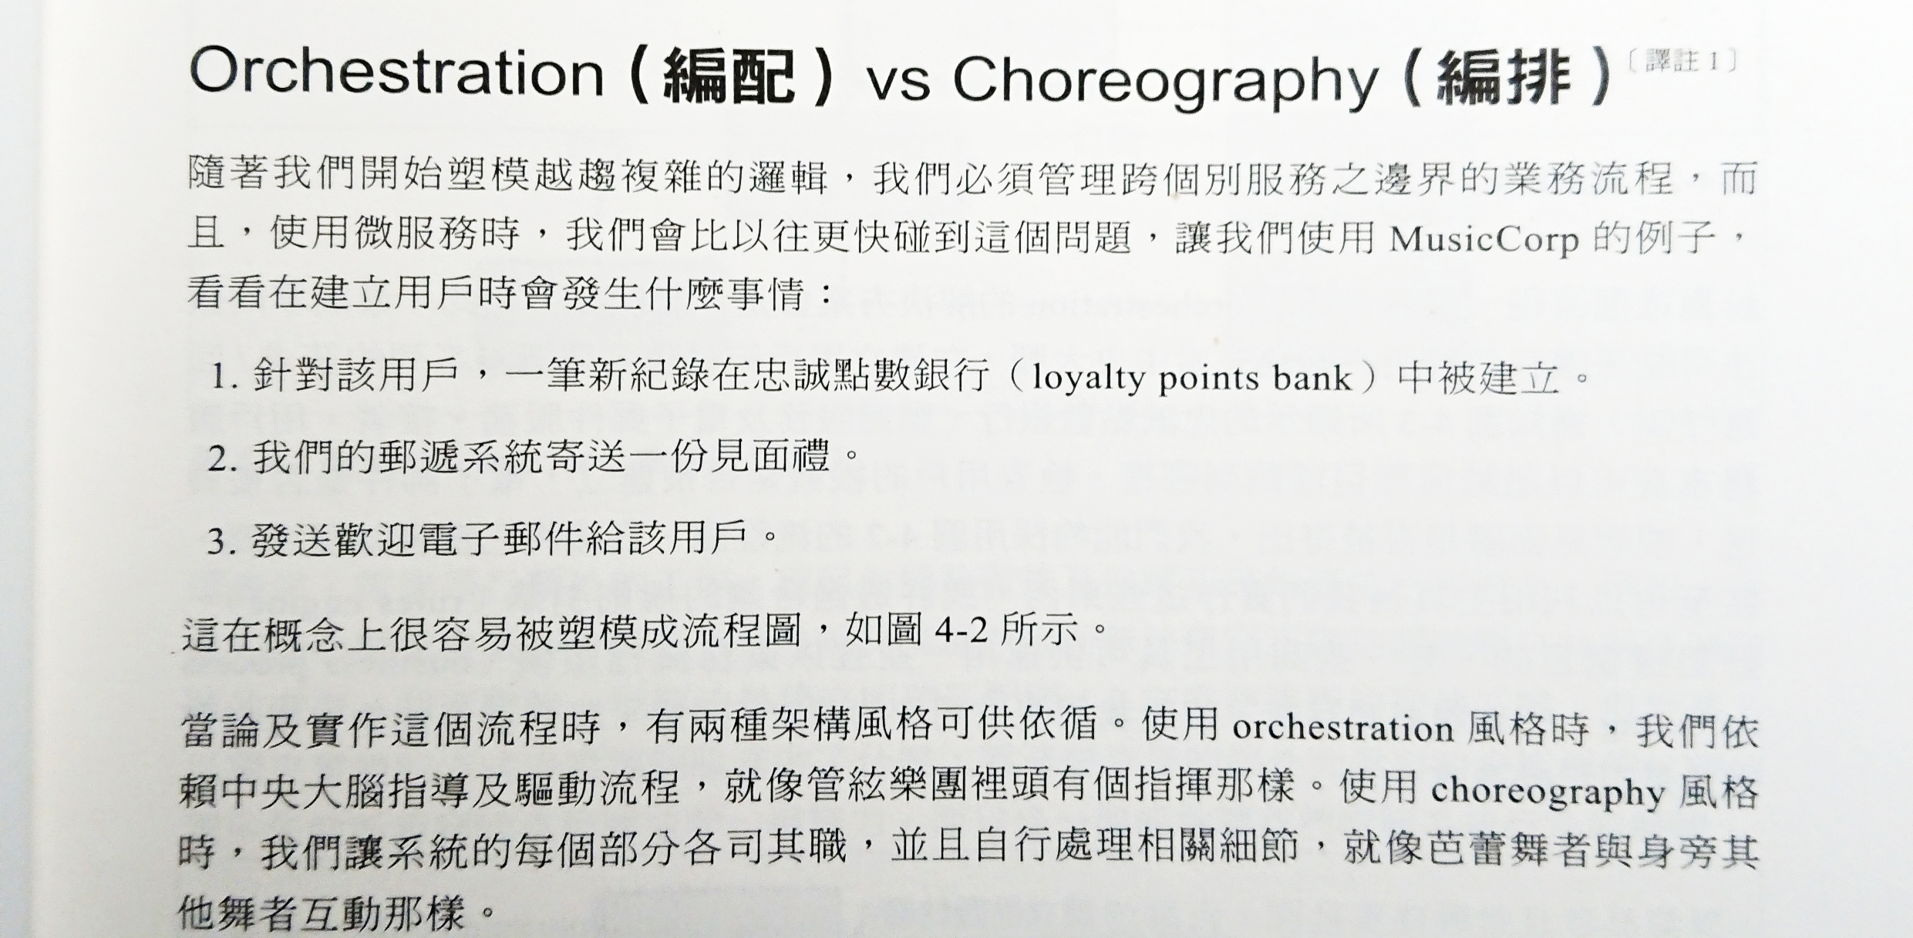

Slide 14
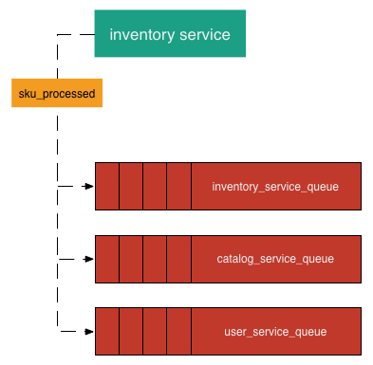
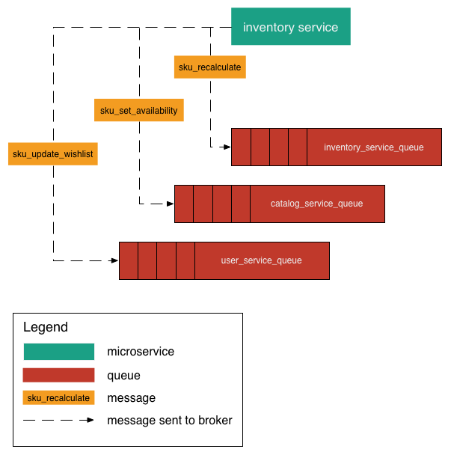
http://howtocookmicroservices.com/communication/

Slide 15
如果我需要等待 queue 處理結果，才能進行下一步?

Slide 16
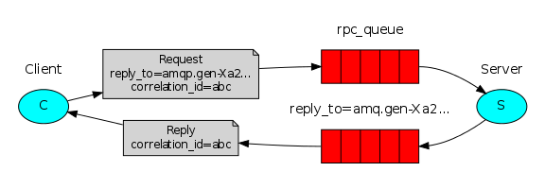
Reply (Callback) Queue
With
Correlation Id
http://www.rabbitmq.com/tutorials/tutorial-six-dotnet.html

Slide 17
實作範例 (.NET Standard 2.0)

Slide 18
Requirement:
Good RPC Server (Implement):
Option: One Worker (Process), Multiple Threads
Must: Graceful Shutdown
Must: Allow Multiple Workers
Must: One Client, Multiple RPC-Call, Consumed By Multiple Worker.
Good RPC Client (Implement):
Must: Async Wait Result from RPC Server
Must: Accept Out of order return sequence

Slide 19
Worker Design
Worker (single thread)
Worker (multiple threads)
RabbitMQ – Connection, Channel, Consumer
Best Practice

Slide 20
RPC Client Design
CorrelationId
Reply Queue
Offical Guideline
RPC Toturials (6)
RabbitMQ Request-Response Pattern
RabbitMQ Features: Direct Reply-To https://www.rabbitmq.com/direct-reply-to.html
http://mikehadlow.blogspot.com/2013/10/rabbitmq-request-response-pattern.html

Slide 21
Worker Design (multi-threading)

Slide 22
https://www.cloudamqp.com/blog/2018-01-19-part4-rabbitmq-13-common-errors.html?utm_medium=email&utm_campaign=13%20common%20RabbitMQ%20mistakes&utm_content=13%20common%20RabbitMQ%20mistakes+CID_624bf38f44697616ac46d64498180791&utm_source=Email%20marketing%20software&utm_term=13%20common%20RabbitMQ%20Mistakes

Slide 29
Demo intro slide

Slide 30
Code Sample Title

Slide 31











特別感謝

Slide 32
Message Queue Based RPC
Andrew Wu

Slide 33
Microservices Patterns: 集中管理 vs 事件驅動

Slide 34



Study4.TW
社團
Study4.TW
粉絲團
fb.com/groups/216312591822635
Study4.TW
fb.com/Study4.tw

Slide 35






特別感謝

Slide 36
Demo:

Slide 37


